Slide 1
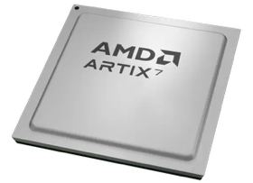
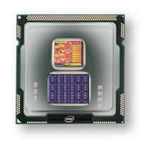
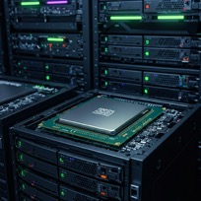
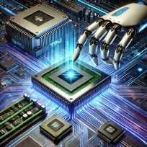
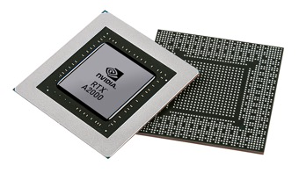


Christof Teuscher
ECE 410/510: Hardware for AI and ML
Hardware for AI and ML: an Overview
Portland State University
Department of Electrical and Computer Engineering (ECE)
www.teuscher-lab.com
teuscher@pdx.edu

Slide 2
What is a computer?

Slide 3
What is computation? (1)
Computation
Mapping
Transformation
Function O_{t+1}=f(I_{t})
Inputs I
Outputs O
…
…
How can we “realize” this mapping?

Slide 4
What is computation? (2)
I₁ | … | I_{N} | O₁ | … | O_{M}
0 | … | 1 | 1 | … | 0
1 | … | 0 | 0 | … | 0
…
Inputs I
Outputs O
…
…
Look-up table
Simple, fast

Slide 5
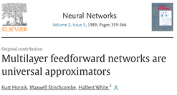
What is computation? (3)
Feedforward
No memory/state
Generalization
Weights
Inputs I
…
Outputs O
…
…
Output nodes
Hidden nodes
Various training algorithms
Guaranteed convergence
Input nodes
Neural network
Universal function approximator
(Hornik, Stinchcombe, White, 1989, https://doi.org/10.1016/0893-6080(89)90020-8)

Slide 6
What is computation? (4)
Inputs I
Outputs O
…
…
Feedback
Dynamical system
Memory is needed in a lot of cases
Temporal signal processing (audio, video)
Timeseries prediction
Control tasks

Slide 7
What is computation? (5)
Weights
Recurrent connections
Inputs I
…
Outputs O
…
…
…
Output nodes
Hidden nodes
Dynamical system
Integration over time
Input nodes
Recurrent neural networks (RNN)
Training is challenging, various algorithms exist (backpropagation through time), convergence not
guaranteed, many weights, slow learning. RNNs are also universal function approximators
(Schaefer & Zimmerman, 2007, https://doi.org/10.1142/S0129065707001111)

Slide 8
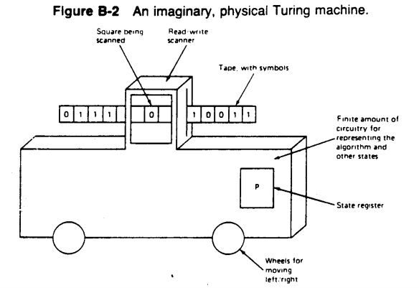
Turing Machine (TM)
Turing’s aim was to define the simplest possible device that could perform any computation that could be performed by a human.
TMs are a model of computability, they do not model the physical process of a computer.
Notes:
There are many (non-computable) functions that cannot be computed by a TM.
Halting problem
Post correspondence problem (PCB)

Slide 9
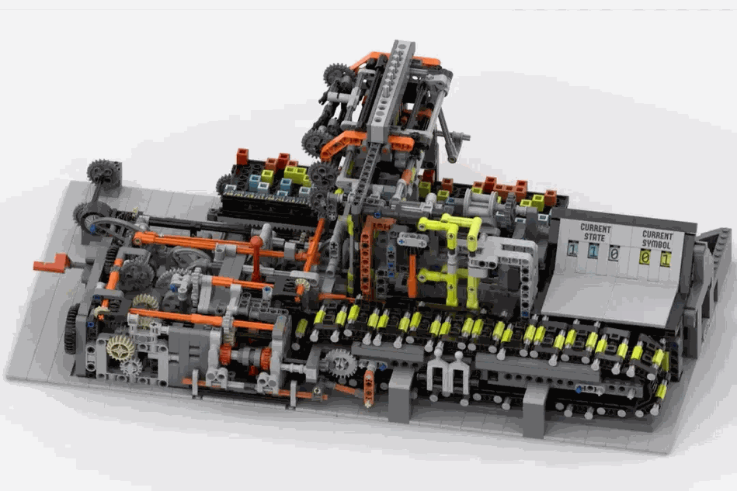
Turing Machine (TM)
“What does a Turing machine look like? You can certainly imagine some crazy looking machine, but a better approach is to look in a mirror.”
— Charles Petzold, The Annotated Turing
https://ideas.lego.com/projects/10a3239f-4562-4d23-ba8e-f4fc94eef5c7
Notes:
There are many (non-computable) functions that cannot be computed by a TM.
Halting problem
Post correspondence problem (PCB)

Slide 10
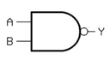

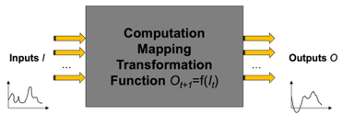
Intrinsic vs designed computation (1)
Designed computation:
top-down
we design devices and circuits for our purpose
information processing that is “useful”
Intrinsic computation:
inherent dynamics of a dynamical system
not necessarily “useful”
Everything computes something, the question is what and how it can be harnessed for “useful” purposes.
“What natural substrates are complex enough to support controllable and useful information processing?” (Crutchfield et al., 2010, https://doi.org/10.1063/1.3492712)
What does a falling apple ”compute?”

Slide 11
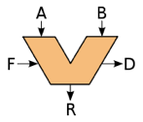
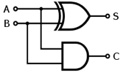
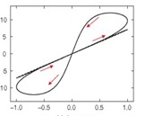
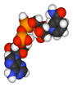
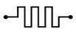
Intrinsic vs designed computation (2)
Desired computation
Computing architecture
How to obtain a desired computation?
Intrinsic dynamics
Device network

Slide 12
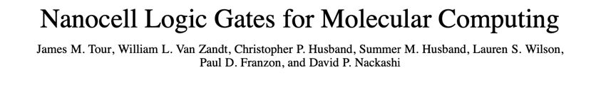
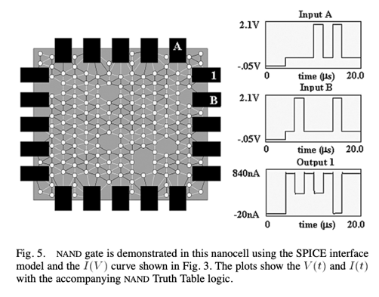
Intrinsic vs designed computation (3)
“Evolvable hardware” variant
Self-assembled network of metallic particles, with reprogrammable negative differential resistance (NDR)
(Tour et al., 2002, http://doi.org/10.1109/TNANO.2002.804744)
Network trained by switching NDR switches ON/OFF at post fabrication.
Omnipotence is assumed (one knows and can control all switches)
Tasks: logic functions, 1 bit-adder
In simulation only

Slide 13
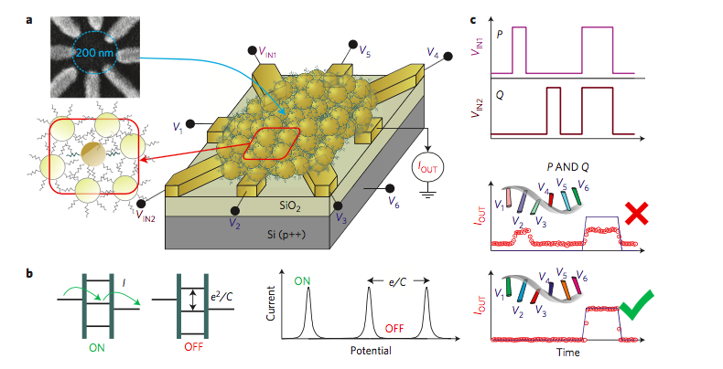
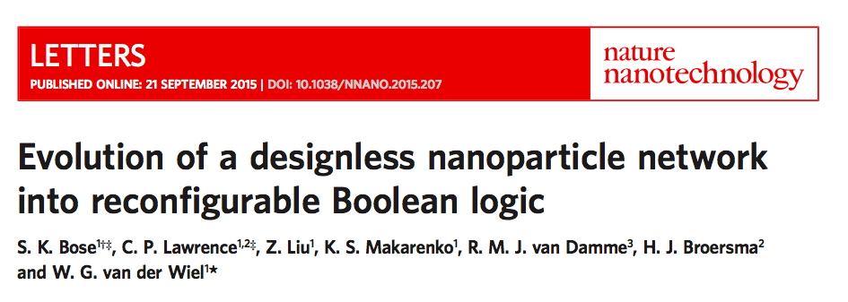
Intrinsic vs designed computation (4)
(Bose et al., 2015, https://doi.org/10.1038/nnano.2015.207)

Slide 14
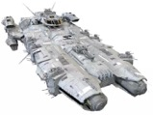

What kind of computing machinery would an extraterrestrial build?

Slide 15
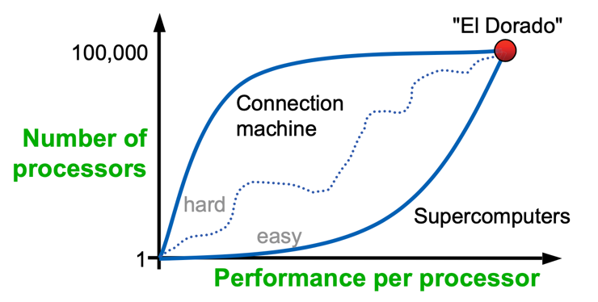
The goals and drivers have changed
Avogadro-scale computing
Large number

Slide 16
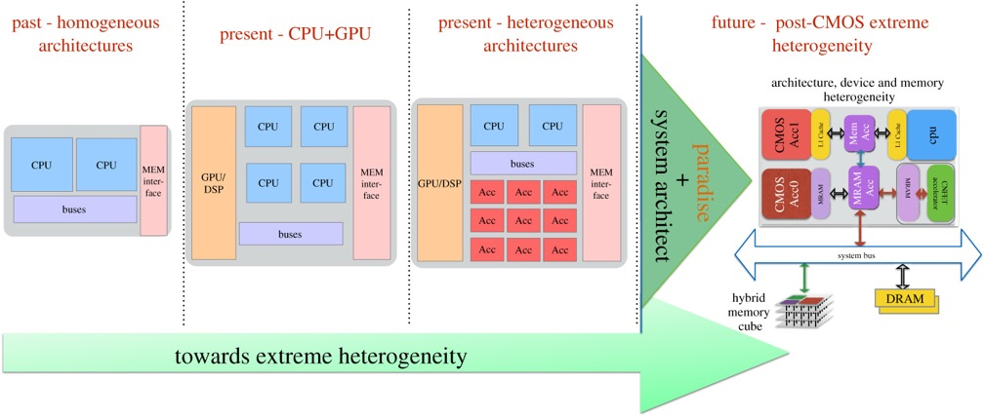
The goals and drivers have changed
https://royalsocietypublishing.org/doi/10.1098/rsta.2019.0061

Slide 17
AI vs ML
Machine Learning (ML) is one technique used to achieve Artificial Intelligence (AI).
All ML is AI, but not all AI is ML.
AI is the destination (e.g., intelligent machines), while ML is one path to get there (learning from data).
Artificial Intelligence (AI): Broader concept encompassing machines that can perform tasks requiring human intelligence. Ultimate goal: Artificial General Intelligence (AGI)
Machine Learning (ML): Subset of AI focused specifically on algorithms that improve through experience. Example: neural networks

Slide 18
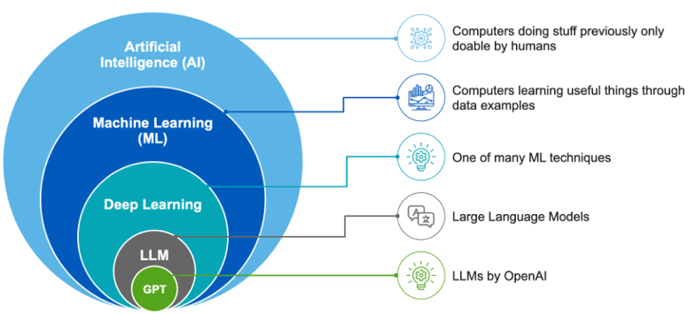
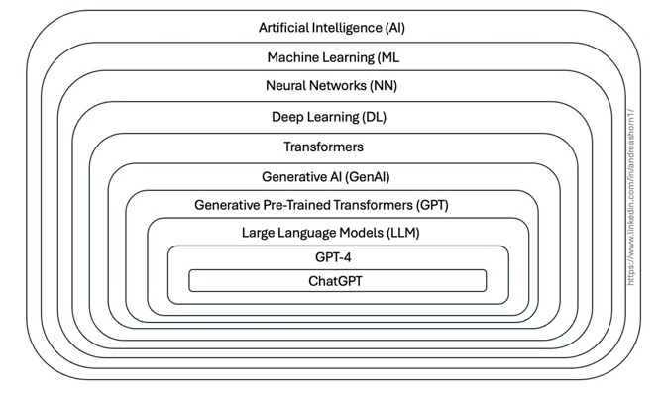
AI vs ML
Source: Tignis

Slide 19
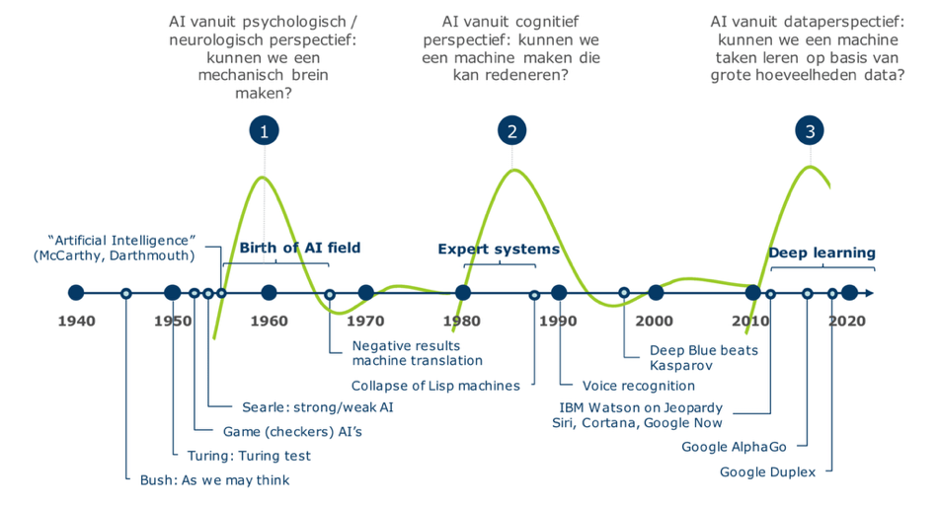
A very brief history of AI
Strong AI = AGI = Artificial General Intelligence

Slide 20
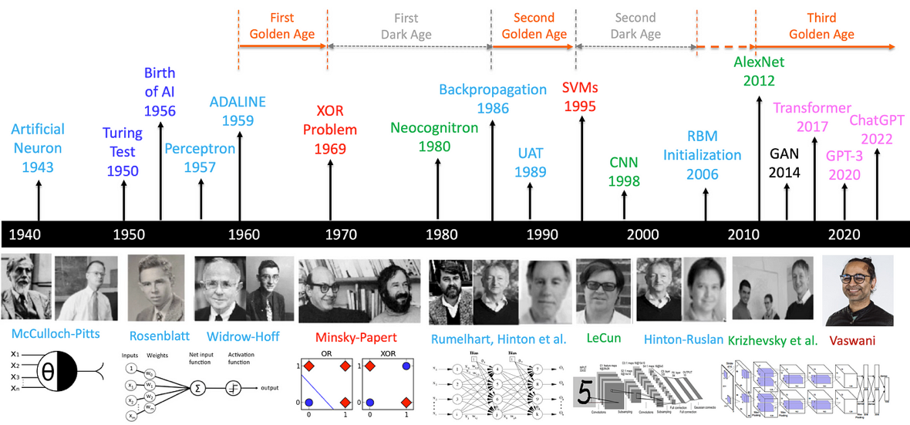
A very brief history of AI with deep learning
https://medium.com/@lmpo/a-brief-history-of-ai-with-deep-learning-26f7948bc87b

Slide 21
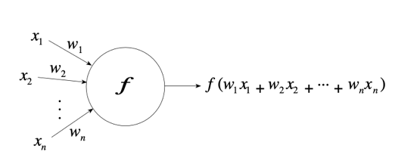
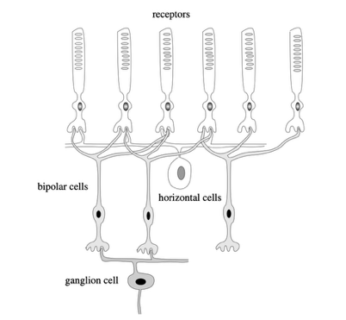
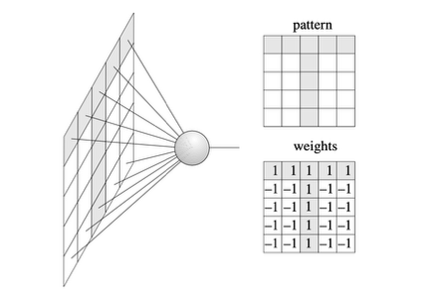
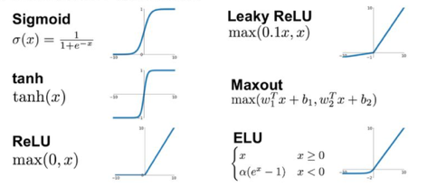
An abstract neuron
Rojas, 1986

Slide 22
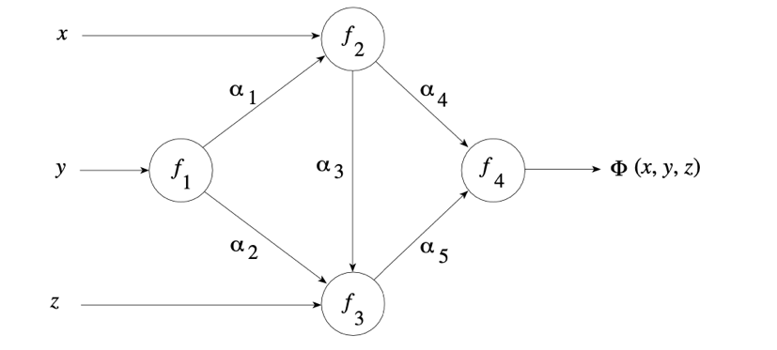
A neural network
Rojas, 1986

Slide 23
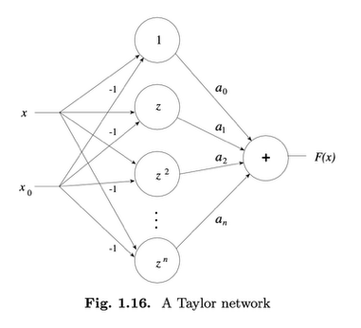
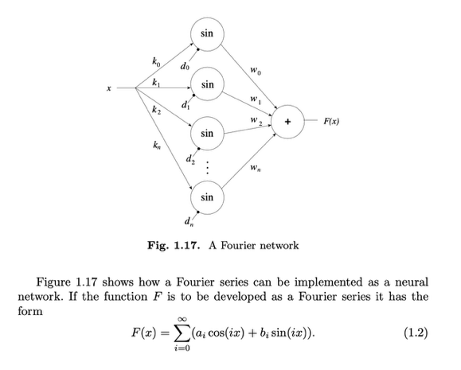
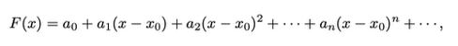
Special types of neural networks
Rojas, 1986

Slide 24
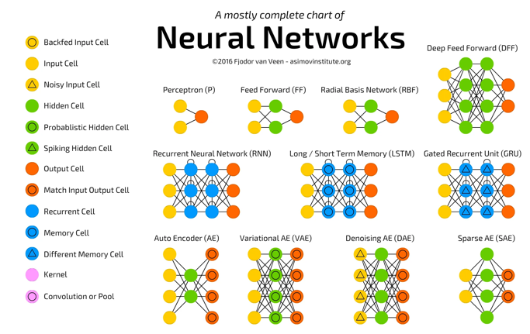
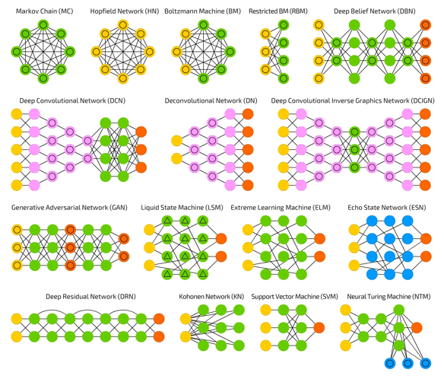
Types of neural networks
(Fjodor van Veen, 2016, asimovinstitute.org)

Slide 25
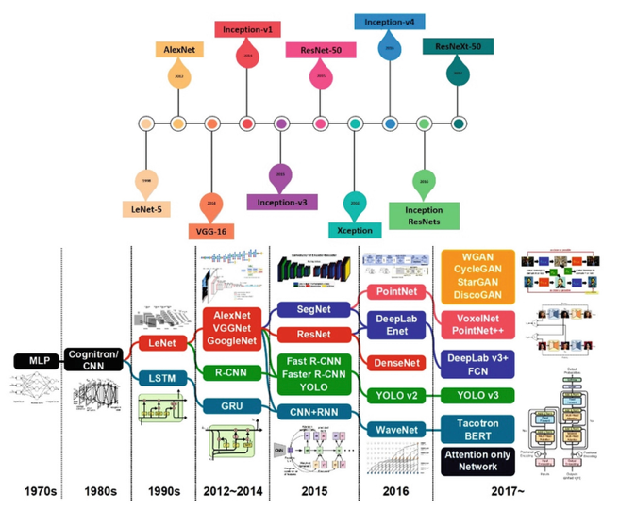

Deep neural networks

Slide 26
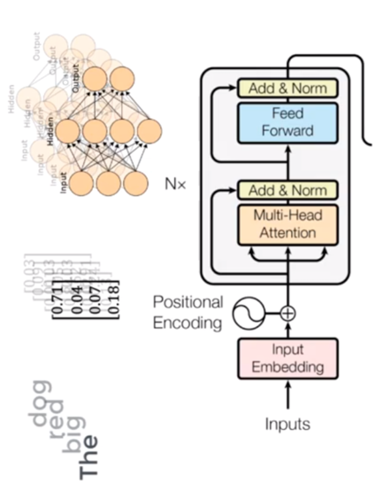
Transformers are deep neural networks
https://builtin.com/artificial-intelligence/transformer-neural-network

Slide 27
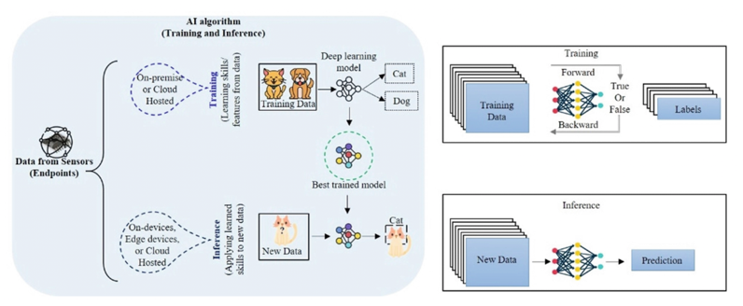
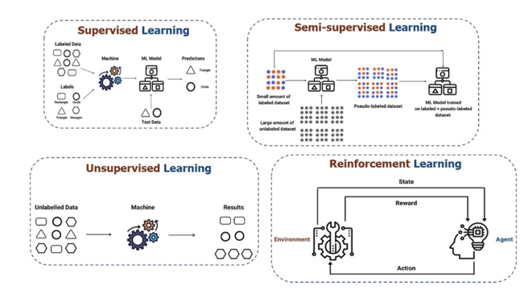
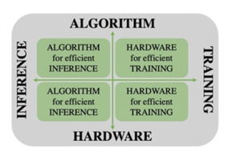
Learning
What is harder? Inference or training?
Mishra et al., 2023

Slide 28
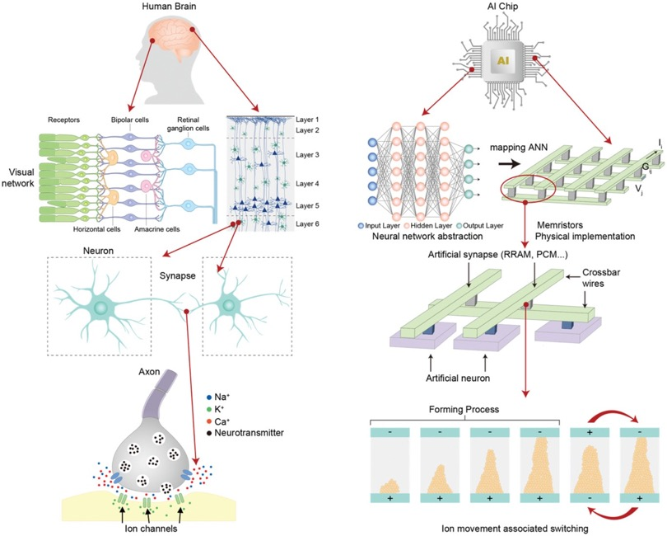
Source: “Bridging Biological and Artificial Neural Networks with Emerging Neuromorphic Devices: Fundamentals, Progress, and Challenges”

Slide 29
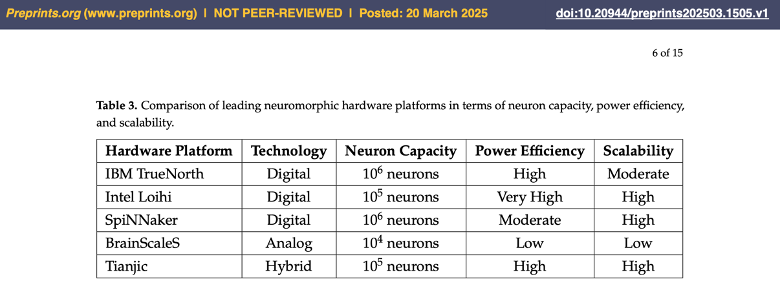
Neuromorphic Computing with Large
Scale Spiking Neural Networks

Slide 30
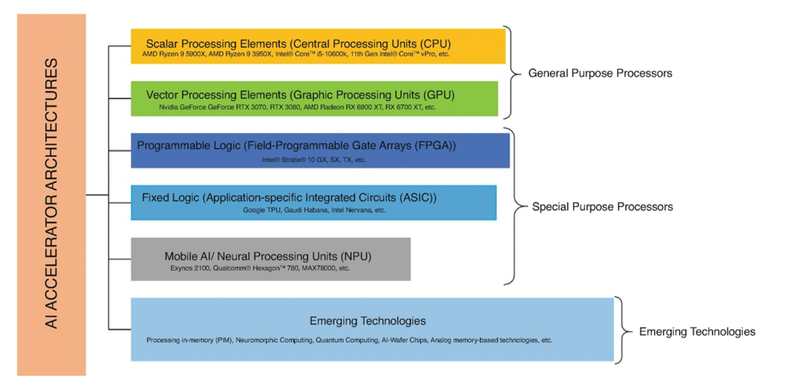
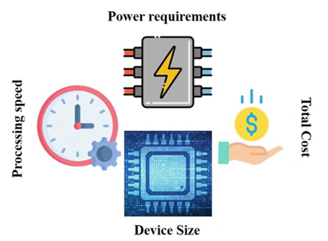
Hardware for AI/ML
Metrics
Mishra et al., 2023

Slide 31
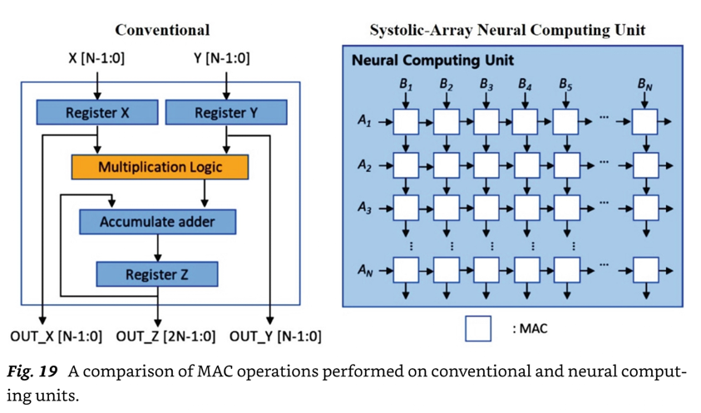
Hardware for AI/ML
Mishra et al., 2023

Slide 32
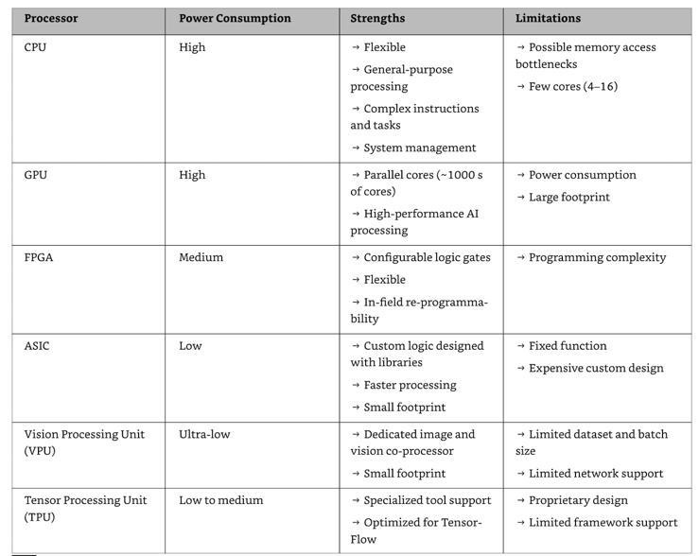
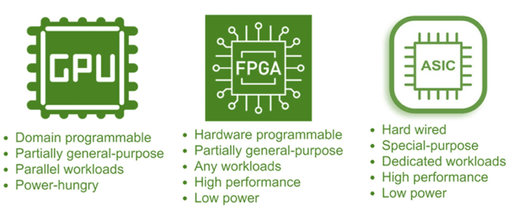
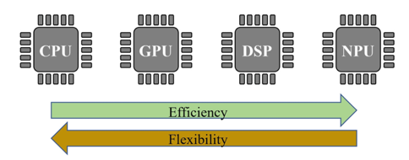
Hardware for AI/ML
Mishra et al., 2023

Slide 33
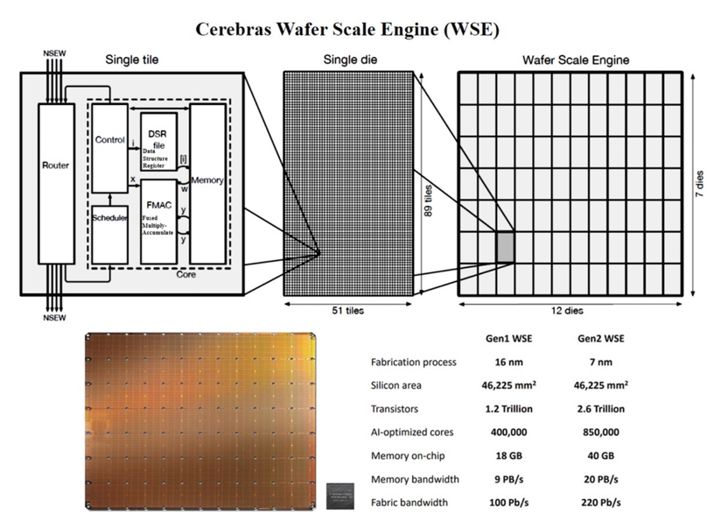
Hardware for AI/ML
Mishra et al., 2023

Slide 34


Co-design & LLM

Slide 35
(HW/SW) Co-design
Classical approach: in college, different technologies are taught in different classes.
Hardware-software co-design:
Started in the 1990s.
Its core idea is the concurrent designs of hardware and software components of complex electronic systems.
More broadly:
The concurrent design of hardware and software across all layers of the compute stack.
What are possible metrics and trade-offs?

Slide 36



Deep co-design across the entire stack

Slide 37
Food for thought
Why is executing a neural network on a general purpose computer inefficient?
What circuitry/processor would you design to find the shortest path in large graphs?
What if the graph is dense?
What if the graph is sparse?
What circuitry/processor would you design to recognize QR codes for an embedded camera?
Recognition needs to be fast and low-power.

